Slide 1
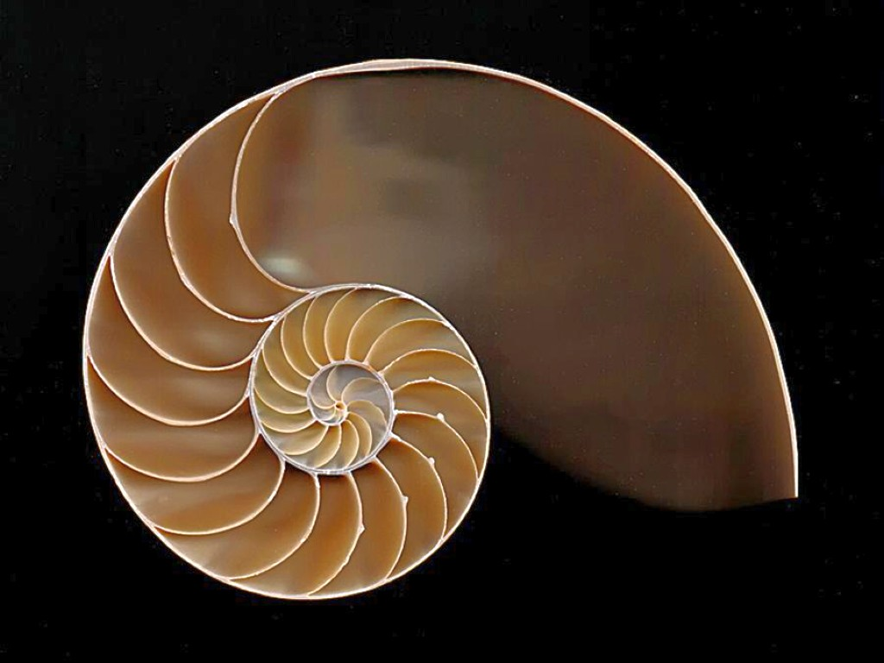
PH1102E/GEK1067
Week 7
The Cosmological Argument

Slide 3
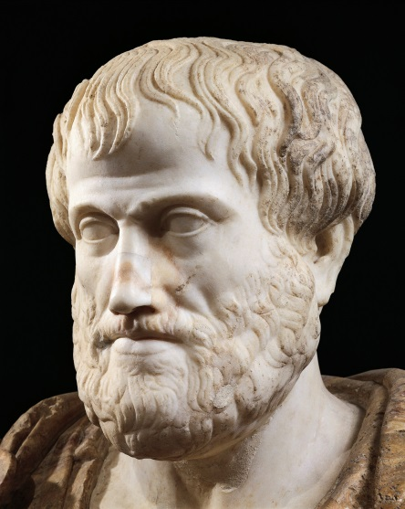


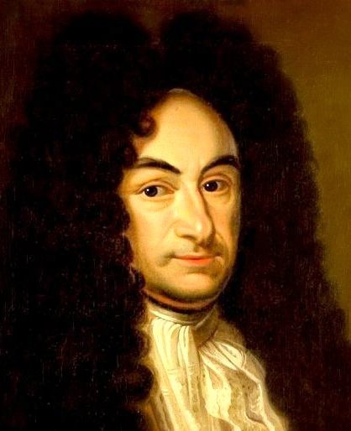
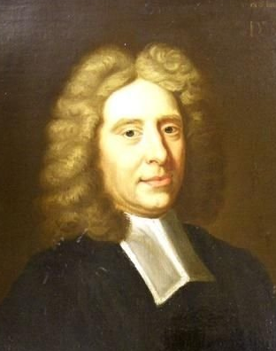
Aristotle
(384-322 BC)
Al-Ghazali
(1058-1111)
Thomas Aquinas
(1225-1274)
Gottfried Leibniz
(1646-1716)
Samuel Clarke
(1675-1729)
Notes:
Aristotle (Greece), Ghazali (Iran), Aquinas (Italy), Leibniz (Germany), Clarke (England)

Slide 5
Define the Cosmos as the sum total of everything that ever happens.
The Cosmos consists of all the contents of time: past, present, and future.
It includes every event that ever takes place anywhere.

Slide 7
Something explains why the Cosmos exists.
If something explains why the Cosmos exists, it is either (a) the Cosmos itself, (b) some part of the Cosmos, or, (c) something else.
So, the existence of the Cosmos is explained by either (a) the Cosmos itself, (b) some part of the Cosmos, or, (c) something else. (from 1 and 2)
The Cosmos does not explain its own existence.
No part of the Cosmos explains why the Cosmos exists.
So, something that is neither the Cosmos itself nor any part of the Cosmos explains why the Cosmos exists. (from 3, 4, and 5)
But something that is neither the Cosmos itself nor any part of the Cosmos is a transcendent being: a force, power, or phenomenon that exists “outside” of time.
So, there exists some transcendent force, power, or phenomenon that explains why the Cosmos exists. (from 6 and 7)
Classic Cosmological Argument

Slide 8
Something explains why the Cosmos exists.
If something explains why the Cosmos exists, it is either (a) the Cosmos itself, (b) some part of the Cosmos, or, (c) something else.
So, the existence of the Cosmos is explained by either (a) the Cosmos itself, (b) some part of the Cosmos, or, (c) something else. (from 1 and 2)
The Cosmos does not explain its own existence.
No part of the Cosmos explains why the Cosmos exists.
So, something that is neither the Cosmos itself nor any part of the Cosmos explains why the Cosmos exists. (from 3, 4, and 5)
But something that is neither the Cosmos itself nor any part of the Cosmos is a transcendent being: a force, power, or phenomenon that exists “outside” of time.
So, there exists some transcendent force, power, or phenomenon that explains why the Cosmos exists. (from 6 and 7)

Slide 9
Something explains why the Cosmos exists.
If something explains why the Cosmos exists, it is either (a) the Cosmos itself, (b) some part of the Cosmos, or, (c) something else.
So, the existence of the Cosmos is explained by either (a) the Cosmos itself, (b) some part of the Cosmos, or, (c) something else. (from 1 and 2)
The Cosmos does not explain its own existence.
No part of the Cosmos explains why the Cosmos exists.
So, something that is neither the Cosmos itself nor any part of the Cosmos explains why the Cosmos exists. (from 3, 4, and 5)
But something that is neither the Cosmos itself nor any part of the Cosmos is a transcendent being: a force, power, or phenomenon that exists “outside” of time.
So, there exists some transcendent force, power, or phenomenon that explains why the Cosmos exists. (from 6 and 7)

Slide 10
Something explains why the Cosmos exists.
If something explains why the Cosmos exists, it is either (a) the Cosmos itself, (b) some part of the Cosmos, or, (c) something else.
So, the existence of the Cosmos is explained by either (a) the Cosmos itself, (b) some part of the Cosmos, or, (c) something else. (from 1 and 2)
The Cosmos does not explain its own existence.
No part of the Cosmos explains why the Cosmos exists.
So, something that is neither the Cosmos itself nor any part of the Cosmos explains why the Cosmos exists. (from 3, 4, and 5)
But something that is neither the Cosmos itself nor any part of the Cosmos is a transcendent being: a force, power, or phenomenon that exists “outside” of time.
So, there exists some transcendent force, power, or phenomenon that explains why the Cosmos exists. (from 6 and 7)
That is, there is some reason why anything ever happens at all---some reason why time is not just completely empty.
(Remember, the Cosmos is defined as the sum total of everything that ever happens at any time.)

Slide 11
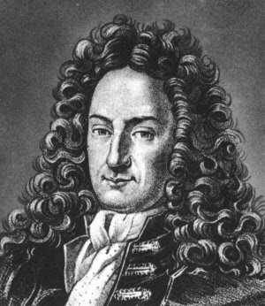
Something explains why the Cosmos exists.
If something explains why the Cosmos exists, it is either (a) the Cosmos itself, (b) some part of the Cosmos, or, (c) something else.
So, the existence of the Cosmos is explained by either (a) the Cosmos itself, (b) some part of the Cosmos, or, (c) something else. (from 1 and 2)
The Cosmos does not explain its own existence.
No part of the Cosmos explains why the Cosmos exists.
So, something that is neither the Cosmos itself nor any part of the Cosmos explains why the Cosmos exists. (from 3, 4, and 5)
But something that is neither the Cosmos itself nor any part of the Cosmos is a transcendent being: a force, power, or phenomenon that exists “outside” of time.
So, there exists some transcendent force, power, or phenomenon that explains why the Cosmos exists. (from 6 and 7)
Gottfried Leibniz
“Why is there something rather than nothing?”

Slide 12
Something explains why the Cosmos exists.
If something explains why the Cosmos exists, it is either (a) the Cosmos itself, (b) some part of the Cosmos, or, (c) something else.
So, the existence of the Cosmos is explained by either (a) the Cosmos itself, (b) some part of the Cosmos, or, (c) something else. (from 1 and 2)
The Cosmos does not explain its own existence.
No part of the Cosmos explains why the Cosmos exists.
So, something that is neither the Cosmos itself nor any part of the Cosmos explains why the Cosmos exists. (from 3, 4, and 5)
But something that is neither the Cosmos itself nor any part of the Cosmos is a transcendent being: a force, power, or phenomenon that exists “outside” of time.
So, there exists some transcendent force, power, or phenomenon that explains why the Cosmos exists. (from 6 and 7)

Slide 13
Something explains why the Cosmos exists.
If something explains why the Cosmos exists, it is either (a) the Cosmos itself, (b) some part of the Cosmos, or, (c) something else.
So, the existence of the Cosmos is explained by either (a) the Cosmos itself, (b) some part of the Cosmos, or, (c) something else. (from 1 and 2)
The Cosmos does not explain its own existence.
No part of the Cosmos explains why the Cosmos exists.
So, something that is neither the Cosmos itself nor any part of the Cosmos explains why the Cosmos exists. (from 3, 4, and 5)
But something that is neither the Cosmos itself nor any part of the Cosmos is a transcendent being: a force, power, or phenomenon that exists “outside” of time.
So, there exists some transcendent force, power, or phenomenon that explains why the Cosmos exists. (from 6 and 7)

Slide 14
Something explains why the Cosmos exists.
If something explains why the Cosmos exists, it is either (a) the Cosmos itself, (b) some part of the Cosmos, or, (c) something else.
So, the existence of the Cosmos is explained by either (a) the Cosmos itself, (b) some part of the Cosmos, or, (c) something else. (from 1 and 2)
The Cosmos does not explain its own existence.
No part of the Cosmos explains why the Cosmos exists.
So, something that is neither the Cosmos itself nor any part of the Cosmos explains why the Cosmos exists. (from 3, 4, and 5)
But something that is neither the Cosmos itself nor any part of the Cosmos is a transcendent being: a force, power, or phenomenon that exists “outside” of time.
So, there exists some transcendent force, power, or phenomenon that explains why the Cosmos exists. (from 6 and 7)
This is a no-brainer: if something explains X, then the explanation has to be either:
X
part of X
none of the above (i.e., something that is neither X nor part of X)

Slide 15
Something explains why the Cosmos exists.
If something explains why the Cosmos exists, it is either (a) the Cosmos itself, (b) some part of the Cosmos, or, (c) something else.
So, the existence of the Cosmos is explained by either (a) the Cosmos itself, (b) some part of the Cosmos, or, (c) something else. (from 1 and 2)
The Cosmos does not explain its own existence.
No part of the Cosmos explains why the Cosmos exists.
So, something that is neither the Cosmos itself nor any part of the Cosmos explains why the Cosmos exists. (from 3, 4, and 5)
But something that is neither the Cosmos itself nor any part of the Cosmos is a transcendent being: a force, power, or phenomenon that exists “outside” of time.
So, there exists some transcendent force, power, or phenomenon that explains why the Cosmos exists. (from 6 and 7)

Slide 16
Something explains why the Cosmos exists.
If something explains why the Cosmos exists, it is either (a) the Cosmos itself, (b) some part of the Cosmos, or, (c) something else.
So, the existence of the Cosmos is explained by either (a) the Cosmos itself, (b) some part of the Cosmos, or, (c) something else. (from 1 and 2)
The Cosmos does not explain its own existence.
No part of the Cosmos explains why the Cosmos exists.
So, something that is neither the Cosmos itself nor any part of the Cosmos explains why the Cosmos exists. (from 3, 4, and 5)
But something that is neither the Cosmos itself nor any part of the Cosmos is a transcendent being: a force, power, or phenomenon that exists “outside” of time.
So, there exists some transcendent force, power, or phenomenon that explains why the Cosmos exists. (from 6 and 7)

Slide 17
Something explains why the Cosmos exists.
If something explains why the Cosmos exists, it is either (a) the Cosmos itself, (b) some part of the Cosmos, or, (c) something else.
So, the existence of the Cosmos is explained by either (a) the Cosmos itself, (b) some part of the Cosmos, or, (c) something else. (from 1 and 2)
The Cosmos does not explain its own existence.
No part of the Cosmos explains why the Cosmos exists.
So, something that is neither the Cosmos itself nor any part of the Cosmos explains why the Cosmos exists. (from 3, 4, and 5)
But something that is neither the Cosmos itself nor any part of the Cosmos is a transcendent being: a force, power, or phenomenon that exists “outside” of time.
So, there exists some transcendent force, power, or phenomenon that explains why the Cosmos exists. (from 6 and 7)

Slide 18
Something explains why the Cosmos exists.
If something explains why the Cosmos exists, it is either (a) the Cosmos itself, (b) some part of the Cosmos, or, (c) something else.
So, the existence of the Cosmos is explained by either (a) the Cosmos itself, (b) some part of the Cosmos, or, (c) something else. (from 1 and 2)
The Cosmos does not explain its own existence.
No part of the Cosmos explains why the Cosmos exists.
So, something that is neither the Cosmos itself nor any part of the Cosmos explains why the Cosmos exists. (from 3, 4, and 5)
But something that is neither the Cosmos itself nor any part of the Cosmos is a transcendent being: a force, power, or phenomenon that exists “outside” of time.
So, there exists some transcendent force, power, or phenomenon that explains why the Cosmos exists. (from 6 and 7)
This follows from 1 and 2.
The logic here is just:
P
If P, then Q
So, Q
where P = “something explains why the Cosmos exists,” and Q = “what explains why the Cosmos exists is either (a), (b), or (c)”

Slide 19
Something explains why the Cosmos exists.
If something explains why the Cosmos exists, it is either (a) the Cosmos itself, (b) some part of the Cosmos, or, (c) something else.
So, the existence of the Cosmos is explained by either (a) the Cosmos itself, (b) some part of the Cosmos, or, (c) something else. (from 1 and 2)
The Cosmos does not explain its own existence.
No part of the Cosmos explains why the Cosmos exists.
So, something that is neither the Cosmos itself nor any part of the Cosmos explains why the Cosmos exists. (from 3, 4, and 5)
But something that is neither the Cosmos itself nor any part of the Cosmos is a transcendent being: a force, power, or phenomenon that exists “outside” of time.
So, there exists some transcendent force, power, or phenomenon that explains why the Cosmos exists. (from 6 and 7)

Slide 20
Something explains why the Cosmos exists.
If something explains why the Cosmos exists, it is either (a) the Cosmos itself, (b) some part of the Cosmos, or, (c) something else.
So, the existence of the Cosmos is explained by either (a) the Cosmos itself, (b) some part of the Cosmos, or, (c) something else. (from 1 and 2)
The Cosmos does not explain its own existence.
No part of the Cosmos explains why the Cosmos exists.
So, something that is neither the Cosmos itself nor any part of the Cosmos explains why the Cosmos exists. (from 3, 4, and 5)
But something that is neither the Cosmos itself nor any part of the Cosmos is a transcendent being: a force, power, or phenomenon that exists “outside” of time.
So, there exists some transcendent force, power, or phenomenon that explains why the Cosmos exists. (from 6 and 7)

Slide 21
Something explains why the Cosmos exists.
If something explains why the Cosmos exists, it is either (a) the Cosmos itself, (b) some part of the Cosmos, or, (c) something else.
So, the existence of the Cosmos is explained by either (a) the Cosmos itself, (b) some part of the Cosmos, or, (c) something else. (from 1 and 2)
The Cosmos does not explain its own existence.
No part of the Cosmos explains why the Cosmos exists.
So, something that is neither the Cosmos itself nor any part of the Cosmos explains why the Cosmos exists. (from 3, 4, and 5)
But something that is neither the Cosmos itself nor any part of the Cosmos is a transcendent being: a force, power, or phenomenon that exists “outside” of time.
So, there exists some transcendent force, power, or phenomenon that explains why the Cosmos exists. (from 6 and 7)

Slide 22
Something explains why the Cosmos exists.
If something explains why the Cosmos exists, it is either (a) the Cosmos itself, (b) some part of the Cosmos, or, (c) something else.
So, the existence of the Cosmos is explained by either (a) the Cosmos itself, (b) some part of the Cosmos, or, (c) something else. (from 1 and 2)
The Cosmos does not explain its own existence.
No part of the Cosmos explains why the Cosmos exists.
So, something that is neither the Cosmos itself nor any part of the Cosmos explains why the Cosmos exists. (from 3, 4, and 5)
But something that is neither the Cosmos itself nor any part of the Cosmos is a transcendent being: a force, power, or phenomenon that exists “outside” of time.
So, there exists some transcendent force, power, or phenomenon that explains why the Cosmos exists. (from 6 and 7)
If you say that the Cosmos explains its own existence, you’re saying that the fact that time isn’t empty is explained by the fact that time isn’t empty.
But that is wrong.
So, the Cosmos doesn’t explain its own existence.
Self-explanatory: “1 is less than a million”; “If something thinks, then it exists.”
Non-self-explanatory: “There is something rather than nothing.”

Slide 23
Something explains why the Cosmos exists.
If something explains why the Cosmos exists, it is either (a) the Cosmos itself, (b) some part of the Cosmos, or, (c) something else.
So, the existence of the Cosmos is explained by either (a) the Cosmos itself, (b) some part of the Cosmos, or, (c) something else. (from 1 and 2)
The Cosmos does not explain its own existence.
No part of the Cosmos explains why the Cosmos exists.
So, something that is neither the Cosmos itself nor any part of the Cosmos explains why the Cosmos exists. (from 3, 4, and 5)
But something that is neither the Cosmos itself nor any part of the Cosmos is a transcendent being: a force, power, or phenomenon that exists “outside” of time.
So, there exists some transcendent force, power, or phenomenon that explains why the Cosmos exists. (from 6 and 7)
If you say that the Cosmos explains its own existence, you’re saying that the fact that time isn’t empty is explained by the fact that time isn’t empty.
But that is wrong.
So, the Cosmos doesn’t explain its own existence.
Self-explanatory: “1 is less than a million”; “If something thinks, then it exists.”
Non-self-explanatory: “There is something rather than nothing.”
Notes:
It doesn’t make sense to ask why 1 is less than a million, or why a thing exists if it thinks. But it DOES make sense to ask why there is something rather than nothing.

Slide 24
Something explains why the Cosmos exists.
If something explains why the Cosmos exists, it is either (a) the Cosmos itself, (b) some part of the Cosmos, or, (c) something else.
So, the existence of the Cosmos is explained by either (a) the Cosmos itself, (b) some part of the Cosmos, or, (c) something else. (from 1 and 2)
The Cosmos does not explain its own existence.
No part of the Cosmos explains why the Cosmos exists.
So, something that is neither the Cosmos itself nor any part of the Cosmos explains why the Cosmos exists. (from 3, 4, and 5)
But something that is neither the Cosmos itself nor any part of the Cosmos is a transcendent being: a force, power, or phenomenon that exists “outside” of time.
So, there exists some transcendent force, power, or phenomenon that explains why the Cosmos exists. (from 6 and 7)

Slide 25
Something explains why the Cosmos exists.
If something explains why the Cosmos exists, it is either (a) the Cosmos itself, (b) some part of the Cosmos, or, (c) something else.
So, the existence of the Cosmos is explained by either (a) the Cosmos itself, (b) some part of the Cosmos, or, (c) something else. (from 1 and 2)
The Cosmos does not explain its own existence.
No part of the Cosmos explains why the Cosmos exists.
So, something that is neither the Cosmos itself nor any part of the Cosmos explains why the Cosmos exists. (from 3, 4, and 5)
But something that is neither the Cosmos itself nor any part of the Cosmos is a transcendent being: a force, power, or phenomenon that exists “outside” of time.
So, there exists some transcendent force, power, or phenomenon that explains why the Cosmos exists. (from 6 and 7)

Slide 26
Something explains why the Cosmos exists.
If something explains why the Cosmos exists, it is either (a) the Cosmos itself, (b) some part of the Cosmos, or, (c) something else.
So, the existence of the Cosmos is explained by either (a) the Cosmos itself, (b) some part of the Cosmos, or, (c) something else. (from 1 and 2)
The Cosmos does not explain its own existence.
No part of the Cosmos explains why the Cosmos exists.
So, something that is neither the Cosmos itself nor any part of the Cosmos explains why the Cosmos exists. (from 3, 4, and 5)
But something that is neither the Cosmos itself nor any part of the Cosmos is a transcendent being: a force, power, or phenomenon that exists “outside” of time.
So, there exists some transcendent force, power, or phenomenon that explains why the Cosmos exists. (from 6 and 7)

Slide 27
Something explains why the Cosmos exists.
If something explains why the Cosmos exists, it is either (a) the Cosmos itself, (b) some part of the Cosmos, or, (c) something else.
So, the existence of the Cosmos is explained by either (a) the Cosmos itself, (b) some part of the Cosmos, or, (c) something else. (from 1 and 2)
The Cosmos does not explain its own existence.
No part of the Cosmos explains why the Cosmos exists.
So, something that is neither the Cosmos itself nor any part of the Cosmos explains why the Cosmos exists. (from 3, 4, and 5)
But something that is neither the Cosmos itself nor any part of the Cosmos is a transcendent being: a force, power, or phenomenon that exists “outside” of time.
So, there exists some transcendent force, power, or phenomenon that explains why the Cosmos exists. (from 6 and 7)
Notes:
The idea here is that you can’t explain a whole by reference to its parts.

Slide 28
Something explains why the Cosmos exists.
If something explains why the Cosmos exists, it is either (a) the Cosmos itself, (b) some part of the Cosmos, or, (c) something else.
So, the existence of the Cosmos is explained by either (a) the Cosmos itself, (b) some part of the Cosmos, or, (c) something else. (from 1 and 2)
The Cosmos does not explain its own existence.
No part of the Cosmos explains why the Cosmos exists.
So, something that is neither the Cosmos itself nor any part of the Cosmos explains why the Cosmos exists. (from 3, 4, and 5)
But something that is neither the Cosmos itself nor any part of the Cosmos is a transcendent being: a force, power, or phenomenon that exists “outside” of time.
So, there exists some transcendent force, power, or phenomenon that explains why the Cosmos exists. (from 6 and 7)
Why not? For all we know, the Cosmos is infinitely old. In that case, every part of the Cosmos is preceded by an earlier part (i.e., every event is preceded by an earlier event). So, we can explain every part of the Cosmos by reference to an earlier part.
And if we can explain every part of the Cosmos, then we can explain the whole Cosmos! Each part of the Cosmos gets its existence explained by an earlier part of the Cosmos, and in this way the whole Cosmos has its existence explained.

Slide 29
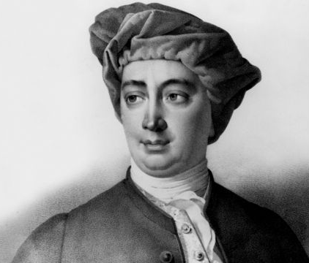
Something explains why the Cosmos exists.
If something explains why the Cosmos exists, it is either (a) the Cosmos itself, (b) some part of the Cosmos, or, (c) something else.
So, the existence of the Cosmos is explained by either (a) the Cosmos itself, (b) some part of the Cosmos, or, (c) something else. (from 1 and 2)
The Cosmos does not explain its own existence.
No part of the Cosmos explains why the Cosmos exists.
So, something that is neither the Cosmos itself nor any part of the Cosmos explains why the Cosmos exists. (from 3, 4, and 5)
But something that is neither the Cosmos itself nor any part of the Cosmos is a transcendent being: a force, power, or phenomenon that exists “outside” of time.
So, there exists some transcendent force, power, or phenomenon that explains why the Cosmos exists. (from 6 and 7)
David Hume

Slide 30
Something explains why the Cosmos exists.
If something explains why the Cosmos exists, it is either (a) the Cosmos itself, (b) some part of the Cosmos, or, (c) something else.
So, the existence of the Cosmos is explained by either (a) the Cosmos itself, (b) some part of the Cosmos, or, (c) something else. (from 1 and 2)
The Cosmos does not explain its own existence.
No part of the Cosmos explains why the Cosmos exists.
So, something that is neither the Cosmos itself nor any part of the Cosmos explains why the Cosmos exists. (from 3, 4, and 5)
But something that is neither the Cosmos itself nor any part of the Cosmos is a transcendent being: a force, power, or phenomenon that exists “outside” of time.
So, there exists some transcendent force, power, or phenomenon that explains why the Cosmos exists. (from 6 and 7)
I reject step 5.
David Hume

Slide 31
Something explains why the Cosmos exists.
If something explains why the Cosmos exists, it is either (a) the Cosmos itself, (b) some part of the Cosmos, or, (c) something else.
So, the existence of the Cosmos is explained by either (a) the Cosmos itself, (b) some part of the Cosmos, or, (c) something else. (from 1 and 2)
The Cosmos does not explain its own existence.
No part of the Cosmos explains why the Cosmos exists.
So, something that is neither the Cosmos itself nor any part of the Cosmos explains why the Cosmos exists. (from 3, 4, and 5)
But something that is neither the Cosmos itself nor any part of the Cosmos is a transcendent being: a force, power, or phenomenon that exists “outside” of time.
So, there exists some transcendent force, power, or phenomenon that explains why the Cosmos exists. (from 6 and 7)
David Hume

Slide 32
Something explains why the Cosmos exists.
If something explains why the Cosmos exists, it is either (a) the Cosmos itself, (b) some part of the Cosmos, or, (c) something else.
So, the existence of the Cosmos is explained by either (a) the Cosmos itself, (b) some part of the Cosmos, or, (c) something else. (from 1 and 2)
The Cosmos does not explain its own existence.
No part of the Cosmos explains why the Cosmos exists.
So, something that is neither the Cosmos itself nor any part of the Cosmos explains why the Cosmos exists. (from 3, 4, and 5)
But something that is neither the Cosmos itself nor any part of the Cosmos is a transcendent being: a force, power, or phenomenon that exists “outside” of time.
So, there exists some transcendent force, power, or phenomenon that explains why the Cosmos exists. (from 6 and 7)
Chambered Nautilus
Notes:
Imagine a super-nautilus that spirals inward infinitely (with ever-smaller chambers: 2, 1, ½, ¼, 1/8, 1/16, … ). Someone says: the largest, outermost chamber was created by something that happened in the next chamber in (the second largest chamber), and the second-largest chamber was created by something that happened in the third-largest chamber, etc., etc., ad infinitum. Has the existence of the super-nautilus now been explained??

Slide 33
Something explains why the Cosmos exists.
If something explains why the Cosmos exists, it is either (a) the Cosmos itself, (b) some part of the Cosmos, or, (c) something else.
So, the existence of the Cosmos is explained by either (a) the Cosmos itself, (b) some part of the Cosmos, or, (c) something else. (from 1 and 2)
The Cosmos does not explain its own existence.
No part of the Cosmos explains why the Cosmos exists.
So, something that is neither the Cosmos itself nor any part of the Cosmos explains why the Cosmos exists. (from 3, 4, and 5)
But something that is neither the Cosmos itself nor any part of the Cosmos is a transcendent being: a force, power, or phenomenon that exists “outside” of time.
So, there exists some transcendent force, power, or phenomenon that explains why the Cosmos exists. (from 6 and 7)
So even if Hume is correct to say that every event is explained by an earlier event, which is explained by an even earlier event, and so on infinitely back into the past, that doesn’t explain why the Cosmos as a whole exists.
It still remains to be explained why this whole infinite series of events exists, just as in the example of the super-nautilus it remains to be explained why the whole infinite series of chambers exists.

Slide 34
Something explains why the Cosmos exists.
If something explains why the Cosmos exists, it is either (a) the Cosmos itself, (b) some part of the Cosmos, or, (c) something else.
So, the existence of the Cosmos is explained by either (a) the Cosmos itself, (b) some part of the Cosmos, or, (c) something else. (from 1 and 2)
The Cosmos does not explain its own existence.
No part of the Cosmos explains why the Cosmos exists.
So, something that is neither the Cosmos itself nor any part of the Cosmos explains why the Cosmos exists. (from 3, 4, and 5)
But something that is neither the Cosmos itself nor any part of the Cosmos is a transcendent being: a force, power, or phenomenon that exists “outside” of time.
So, there exists some transcendent force, power, or phenomenon that explains why the Cosmos exists. (from 6 and 7)

Slide 35
Something explains why the Cosmos exists.
If something explains why the Cosmos exists, it is either (a) the Cosmos itself, (b) some part of the Cosmos, or, (c) something else.
So, the existence of the Cosmos is explained by either (a) the Cosmos itself, (b) some part of the Cosmos, or, (c) something else. (from 1 and 2)
The Cosmos does not explain its own existence.
No part of the Cosmos explains why the Cosmos exists.
So, something that is neither the Cosmos itself nor any part of the Cosmos explains why the Cosmos exists. (from 3, 4, and 5)
But something that is neither the Cosmos itself nor any part of the Cosmos is a transcendent being: a force, power, or phenomenon that exists “outside” of time.
So, there exists some transcendent force, power, or phenomenon that explains why the Cosmos exists. (from 6 and 7)

Slide 36
Something explains why the Cosmos exists.
If something explains why the Cosmos exists, it is either (a) the Cosmos itself, (b) some part of the Cosmos, or, (c) something else.
So, the existence of the Cosmos is explained by either (a) the Cosmos itself, (b) some part of the Cosmos, or, (c) something else. (from 1 and 2)
The Cosmos does not explain its own existence.
No part of the Cosmos explains why the Cosmos exists.
So, something that is neither the Cosmos itself nor any part of the Cosmos explains why the Cosmos exists. (from 3, 4, and 5)
But something that is neither the Cosmos itself nor any part of the Cosmos is a transcendent being: a force, power, or phenomenon that exists “outside” of time.
So, there exists some transcendent force, power, or phenomenon that explains why the Cosmos exists. (from 6 and 7)

Slide 37
Something explains why the Cosmos exists.
If something explains why the Cosmos exists, it is either (a) the Cosmos itself, (b) some part of the Cosmos, or, (c) something else.
So, the existence of the Cosmos is explained by either (a) the Cosmos itself, (b) some part of the Cosmos, or, (c) something else. (from 1 and 2)
The Cosmos does not explain its own existence.
No part of the Cosmos explains why the Cosmos exists.
So, something that is neither the Cosmos itself nor any part of the Cosmos explains why the Cosmos exists. (from 3, 4, and 5)
But something that is neither the Cosmos itself nor any part of the Cosmos is a transcendent being: a force, power, or phenomenon that exists “outside” of time.
So, there exists some transcendent force, power, or phenomenon that explains why the Cosmos exists. (from 6 and 7)
This follows from 3, 4, and 5.
3 says that the Cosmos is explained by (a), (b), or (c).
4 says that it is not explained by (a).
5 says that it is not explained by (b).
So, it must be explained by (c).

Slide 38
Something explains why the Cosmos exists.
If something explains why the Cosmos exists, it is either (a) the Cosmos itself, (b) some part of the Cosmos, or, (c) something else.
So, the existence of the Cosmos is explained by either (a) the Cosmos itself, (b) some part of the Cosmos, or, (c) something else. (from 1 and 2)
The Cosmos does not explain its own existence.
No part of the Cosmos explains why the Cosmos exists.
So, something that is neither the Cosmos itself nor any part of the Cosmos explains why the Cosmos exists. (from 3, 4, and 5)
But something that is neither the Cosmos itself nor any part of the Cosmos is a transcendent being: a force, power, or phenomenon that exists “outside” of time.
So, there exists some transcendent force, power, or phenomenon that explains why the Cosmos exists. (from 6 and 7)

Slide 39
Something explains why the Cosmos exists.
If something explains why the Cosmos exists, it is either (a) the Cosmos itself, (b) some part of the Cosmos, or, (c) something else.
So, the existence of the Cosmos is explained by either (a) the Cosmos itself, (b) some part of the Cosmos, or, (c) something else. (from 1 and 2)
The Cosmos does not explain its own existence.
No part of the Cosmos explains why the Cosmos exists.
So, something that is neither the Cosmos itself nor any part of the Cosmos explains why the Cosmos exists. (from 3, 4, and 5)
But something that is neither the Cosmos itself nor any part of the Cosmos is a transcendent being: a force, power, or phenomenon that exists “outside” of time.
So, there exists some transcendent force, power, or phenomenon that explains why the Cosmos exists. (from 6 and 7)

Slide 40
Something explains why the Cosmos exists.
If something explains why the Cosmos exists, it is either (a) the Cosmos itself, (b) some part of the Cosmos, or, (c) something else.
So, the existence of the Cosmos is explained by either (a) the Cosmos itself, (b) some part of the Cosmos, or, (c) something else. (from 1 and 2)
The Cosmos does not explain its own existence.
No part of the Cosmos explains why the Cosmos exists.
So, something that is neither the Cosmos itself nor any part of the Cosmos explains why the Cosmos exists. (from 3, 4, and 5)
But something that is neither the Cosmos itself nor any part of the Cosmos is a transcendent being: a force, power, or phenomenon that exists “outside” of time.
So, there exists some transcendent force, power, or phenomenon that explains why the Cosmos exists. (from 6 and 7)

Slide 41
Something explains why the Cosmos exists.
If something explains why the Cosmos exists, it is either (a) the Cosmos itself, (b) some part of the Cosmos, or, (c) something else.
So, the existence of the Cosmos is explained by either (a) the Cosmos itself, (b) some part of the Cosmos, or, (c) something else. (from 1 and 2)
The Cosmos does not explain its own existence.
No part of the Cosmos explains why the Cosmos exists.
So, something that is neither the Cosmos itself nor any part of the Cosmos explains why the Cosmos exists. (from 3, 4, and 5)
But something that is neither the Cosmos itself nor any part of the Cosmos is a transcendent being: a force, power, or phenomenon that exists “outside” of time.
So, there exists some transcendent force, power, or phenomenon that explains why the Cosmos exists. (from 6 and 7)
Remember: the Cosmos includes everything that exists in time.
So, if the Cosmos has its existence explained by something that is neither the Cosmos nor any part of the Cosmos, it has its existence explained by something that does not exist in time.

Slide 42
Something explains why the Cosmos exists.
If something explains why the Cosmos exists, it is either (a) the Cosmos itself, (b) some part of the Cosmos, or, (c) something else.
So, the existence of the Cosmos is explained by either (a) the Cosmos itself, (b) some part of the Cosmos, or, (c) something else. (from 1 and 2)
The Cosmos does not explain its own existence.
No part of the Cosmos explains why the Cosmos exists.
So, something that is neither the Cosmos itself nor any part of the Cosmos explains why the Cosmos exists. (from 3, 4, and 5)
But something that is neither the Cosmos itself nor any part of the Cosmos is a transcendent being: a force, power, or phenomenon that exists “outside” of time.
So, there exists some transcendent force, power, or phenomenon that explains why the Cosmos exists. (from 6 and 7)

Slide 43
Something explains why the Cosmos exists.
If something explains why the Cosmos exists, it is either (a) the Cosmos itself, (b) some part of the Cosmos, or, (c) something else.
So, the existence of the Cosmos is explained by either (a) the Cosmos itself, (b) some part of the Cosmos, or, (c) something else. (from 1 and 2)
The Cosmos does not explain its own existence.
No part of the Cosmos explains why the Cosmos exists.
So, something that is neither the Cosmos itself nor any part of the Cosmos explains why the Cosmos exists. (from 3, 4, and 5)
But something that is neither the Cosmos itself nor any part of the Cosmos is a transcendent being: a force, power, or phenomenon that exists “outside” of time.
So, there exists some transcendent force, power, or phenomenon that explains why the Cosmos exists. (from 6 and 7)

Slide 44
Something explains why the Cosmos exists.
If something explains why the Cosmos exists, it is either (a) the Cosmos itself, (b) some part of the Cosmos, or, (c) something else.
So, the existence of the Cosmos is explained by either (a) the Cosmos itself, (b) some part of the Cosmos, or, (c) something else. (from 1 and 2)
The Cosmos does not explain its own existence.
No part of the Cosmos explains why the Cosmos exists.
So, something that is neither the Cosmos itself nor any part of the Cosmos explains why the Cosmos exists. (from 3, 4, and 5)
But something that is neither the Cosmos itself nor any part of the Cosmos is a transcendent being: a force, power, or phenomenon that exists “outside” of time.
So, there exists some transcendent force, power, or phenomenon that explains why the Cosmos exists. (from 6 and 7)

Slide 45
Something explains why the Cosmos exists.
If something explains why the Cosmos exists, it is either (a) the Cosmos itself, (b) some part of the Cosmos, or, (c) something else.
So, the existence of the Cosmos is explained by either (a) the Cosmos itself, (b) some part of the Cosmos, or, (c) something else. (from 1 and 2)
The Cosmos does not explain its own existence.
No part of the Cosmos explains why the Cosmos exists.
So, something that is neither the Cosmos itself nor any part of the Cosmos explains why the Cosmos exists. (from 3, 4, and 5)
But something that is neither the Cosmos itself nor any part of the Cosmos is a transcendent being: a force, power, or phenomenon that exists “outside” of time.
So, there exists some transcendent force, power, or phenomenon that explains why the Cosmos exists. (from 6 and 7)
This follows directly from 6 and 7.

Slide 46
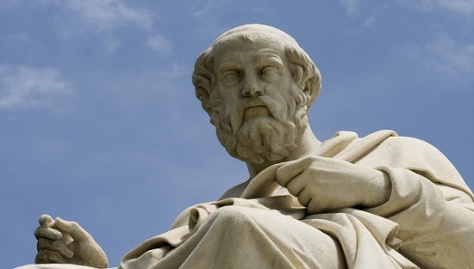
Something explains why the Cosmos exists.
If something explains why the Cosmos exists, it is either (a) the Cosmos itself, (b) some part of the Cosmos, or, (c) something else.
So, the existence of the Cosmos is explained by either (a) the Cosmos itself, (b) some part of the Cosmos, or, (c) something else. (from 1 and 2)
The Cosmos does not explain its own existence.
No part of the Cosmos explains why the Cosmos exists.
So, something that is neither the Cosmos itself nor any part of the Cosmos explains why the Cosmos exists. (from 3, 4, and 5)
But something that is neither the Cosmos itself nor any part of the Cosmos is a transcendent being: a force, power, or phenomenon that exists “outside” of time.
So, there exists some transcendent force, power, or phenomenon that explains why the Cosmos exists. (from 6 and 7)
Plato (427-347 BC)
“Time is a moving image of eternity.”

Slide 47
Something explains why the Cosmos exists.
If something explains why the Cosmos exists, it is either (a) the Cosmos itself, (b) some part of the Cosmos, or, (c) something else.
So, the existence of the Cosmos is explained by either (a) the Cosmos itself, (b) some part of the Cosmos, or, (c) something else. (from 1 and 2)
The Cosmos does not explain its own existence.
No part of the Cosmos explains why the Cosmos exists.
So, something that is neither the Cosmos itself nor any part of the Cosmos explains why the Cosmos exists. (from 3, 4, and 5)
But something that is neither the Cosmos itself nor any part of the Cosmos is a transcendent being: a force, power, or phenomenon that exists “outside” of time.
So, there exists some transcendent force, power, or phenomenon that explains why the Cosmos exists. (from 6 and 7)

Slide 48
Something explains why the Cosmos exists.
If something explains why the Cosmos exists, it is either (a) the Cosmos itself, (b) some part of the Cosmos, or, (c) something else.
So, the existence of the Cosmos is explained by either (a) the Cosmos itself, (b) some part of the Cosmos, or, (c) something else. (from 1 and 2)
The Cosmos does not explain its own existence.
No part of the Cosmos explains why the Cosmos exists.
So, something that is neither the Cosmos itself nor any part of the Cosmos explains why the Cosmos exists. (from 3, 4, and 5)
But something that is neither the Cosmos itself nor any part of the Cosmos is a transcendent being: a force, power, or phenomenon that exists “outside” of time.
So, there exists some transcendent force, power, or phenomenon that explains why the Cosmos exists. (from 6 and 7)
Leibniz
“Therefore, the reasons for the world lie hidden in something extramundane, different from the chain of states, or from the series of things, the collection of which constitutes the world.”

Slide 49
Something explains why the Cosmos exists.
If something explains why the Cosmos exists, it is either (a) the Cosmos itself, (b) some part of the Cosmos, or, (c) something else.
So, the existence of the Cosmos is explained by either (a) the Cosmos itself, (b) some part of the Cosmos, or, (c) something else. (from 1 and 2)
The Cosmos does not explain its own existence.
No part of the Cosmos explains why the Cosmos exists.
So, something that is neither the Cosmos itself nor any part of the Cosmos explains why the Cosmos exists. (from 3, 4, and 5)
But something that is neither the Cosmos itself nor any part of the Cosmos is a transcendent being: a force, power, or phenomenon that exists “outside” of time.
So, there exists some transcendent force, power, or phenomenon that explains why the Cosmos exists. (from 6 and 7)

Slide 50
Something explains why the Cosmos exists.
If something explains why the Cosmos exists, it is either (a) the Cosmos itself, (b) some part of the Cosmos, or, (c) something else.
So, the existence of the Cosmos is explained by either (a) the Cosmos itself, (b) some part of the Cosmos, or, (c) something else. (from 1 and 2)
The Cosmos does not explain its own existence.
No part of the Cosmos explains why the Cosmos exists.
So, something that is neither the Cosmos itself nor any part of the Cosmos explains why the Cosmos exists. (from 3, 4, and 5)
But something that is neither the Cosmos itself nor any part of the Cosmos is a transcendent being: a force, power, or phenomenon that exists “outside” of time.
So, there exists some transcendent force, power, or phenomenon that explains why the Cosmos exists. (from 6 and 7)

Slide 51
Something explains why the Cosmos exists.
If something explains why the Cosmos exists, it is either (a) the Cosmos itself, (b) some part of the Cosmos, or, (c) something else.
So, the existence of the Cosmos is explained by either (a) the Cosmos itself, (b) some part of the Cosmos, or, (c) something else. (from 1 and 2)
The Cosmos does not explain its own existence.
No part of the Cosmos explains why the Cosmos exists.
So, something that is neither the Cosmos itself nor any part of the Cosmos explains why the Cosmos exists. (from 3, 4, and 5)
But something that is neither the Cosmos itself nor any part of the Cosmos is a transcendent being: a force, power, or phenomenon that exists “outside” of time.
So, there exists some transcendent force, power, or phenomenon that explains why the Cosmos exists. (from 6 and 7)
Why should we believe this?

Slide 52
Something explains why the Cosmos exists.
If something explains why the Cosmos exists, it is either (a) the Cosmos itself, (b) some part of the Cosmos, or, (c) something else.
So, the existence of the Cosmos is explained by either (a) the Cosmos itself, (b) some part of the Cosmos, or, (c) something else. (from 1 and 2)
The Cosmos does not explain its own existence.
No part of the Cosmos explains why the Cosmos exists.
So, something that is neither the Cosmos itself nor any part of the Cosmos explains why the Cosmos exists. (from 3, 4, and 5)
But something that is neither the Cosmos itself nor any part of the Cosmos is a transcendent being: a force, power, or phenomenon that exists “outside” of time.
So, there exists some transcendent force, power, or phenomenon that explains why the Cosmos exists. (from 6 and 7)

Slide 53
Something explains why the Cosmos exists.
If something explains why the Cosmos exists, it is either (a) the Cosmos itself, (b) some part of the Cosmos, or, (c) something else.
So, the existence of the Cosmos is explained by either (a) the Cosmos itself, (b) some part of the Cosmos, or, (c) something else. (from 1 and 2)
The Cosmos does not explain its own existence.
No part of the Cosmos explains why the Cosmos exists.
So, something that is neither the Cosmos itself nor any part of the Cosmos explains why the Cosmos exists. (from 3, 4, and 5)
But something that is neither the Cosmos itself nor any part of the Cosmos is a transcendent being: a force, power, or phenomenon that exists “outside” of time.
So, there exists some transcendent force, power, or phenomenon that explains why the Cosmos exists. (from 6 and 7)
Dilemma: either (1) everything has an explanation, or, (2) there is something that does not have an explanation.
If (1), then whatever explains the Cosmos has an explan-ation, and whatever explains that which explains the Cosmos has an explanation, etc., etc. In that case there is no “first” or pre-eminent explanation of things, such as God is supposed to be.
If (2) then for all we know the Cosmos itself is something that does not have an explanation.

Slide 54
Something explains why the Cosmos exists.
If something explains why the Cosmos exists, it is either (a) the Cosmos itself, (b) some part of the Cosmos, or, (c) something else.
So, the existence of the Cosmos is explained by either (a) the Cosmos itself, (b) some part of the Cosmos, or, (c) something else. (from 1 and 2)
The Cosmos does not explain its own existence.
No part of the Cosmos explains why the Cosmos exists.
So, something that is neither the Cosmos itself nor any part of the Cosmos explains why the Cosmos exists. (from 3, 4, and 5)
But something that is neither the Cosmos itself nor any part of the Cosmos is a transcendent being: a force, power, or phenomenon that exists “outside” of time.
So, there exists some transcendent force, power, or phenomenon that explains why the Cosmos exists. (from 6 and 7)
Dilemma: either (1) everything has an explanation, or, (2) there is something that does not have an explanation.
If (1), then whatever explains the Cosmos has an explan-ation, and whatever explains that which explains the Cosmos has an explanation, etc., etc. In that case there is no “first” or pre-eminent explanation of things, such as God is supposed to be.
If (2) then for all we know the Cosmos itself is something that does not have an explanation.

Slide 55
Something explains why the Cosmos exists.
If something explains why the Cosmos exists, it is either (a) the Cosmos itself, (b) some part of the Cosmos, or, (c) something else.
So, the existence of the Cosmos is explained by either (a) the Cosmos itself, (b) some part of the Cosmos, or, (c) something else. (from 1 and 2)
The Cosmos does not explain its own existence.
No part of the Cosmos explains why the Cosmos exists.
So, something that is neither the Cosmos itself nor any part of the Cosmos explains why the Cosmos exists. (from 3, 4, and 5)
But something that is neither the Cosmos itself nor any part of the Cosmos is a transcendent being: a force, power, or phenomenon that exists “outside” of time.
So, there exists some transcendent force, power, or phenomenon that explains why the Cosmos exists. (from 6 and 7)
Dilemma: either (1) everything has an explanation, or, (2) there is something that does not have an explanation.
If (1), then whatever explains the Cosmos has an explan-ation, and whatever explains that which explains the Cosmos has an explanation, etc., etc. In that case there is no “first” or pre-eminent explanation of things, such as God is supposed to be.
If (2), then for all we know the Cosmos itself is something that does not have an explanation.

Slide 56
This is not the end of the story!

Slide 57
This is not the end of the story!
To hear the rest, take:
PH2211: Philosophy of Religion

Slide 58
End of lecture.

Slide 59
Weekly Assignment #6
Summarize Frank Jackson’s article, “Epiphenomenal Qualia.”
Limit: 200 words.
Upload by: 8pm, Thursday 9 October

